Slide 1
Design and implementation of Hotel Management System
Name: Shubh Gangar
Roll No: 1911013
Batch : A1

Slide 2
Abstract
The competition between hotels is becoming more and more fierce, so improving the management level of hotels, implementing the information construction is undoubtedly a wise choice.
According to the characteristics of hotel room management, this system uses Java Swing technology and MySql database to connect, and develops under the development tool of Myeclipse.
With this system, hotel room can be managed conveniently and quickly.

Slide 3
Introduction
Hotels need to use useful and efficient information technology to expand their business scope and space, in order to reduce their operating and management costs , improve management and decision-making efficiency.
Current situation of domestic hostels are:
1) The unclear demand makes the hotel project strong in engineering and insufficient in productisation.
2) There is no unified standard in the industry, and manufacturers operate independently

Slide 4
3) Product promotion relies on administrative means and network, which inhibits the introduction of new technology and technological innovation.
4) The entry of foreign excellent brands at a low price monopolizes the domestic market, and the profit space of developers gradually decreases.
In this system, users can login the hotel room management system, and then operate the functions under their authority.
The system adopts modular programming method, and divides the management platform into different modules according to the needs of users.
The interface of the system is simple which enables it easy to operate.

Slide 5
System Structure Design
This system adopts a three tier architecture which is based on a client / server structure (C/S).
It is divided into 3 layers:
1) Presentation Layer: After visiting the platform, the client will display the calculation according to the specific business logic and rules, and then display the results. It follows C/S architecture.

Slide 6
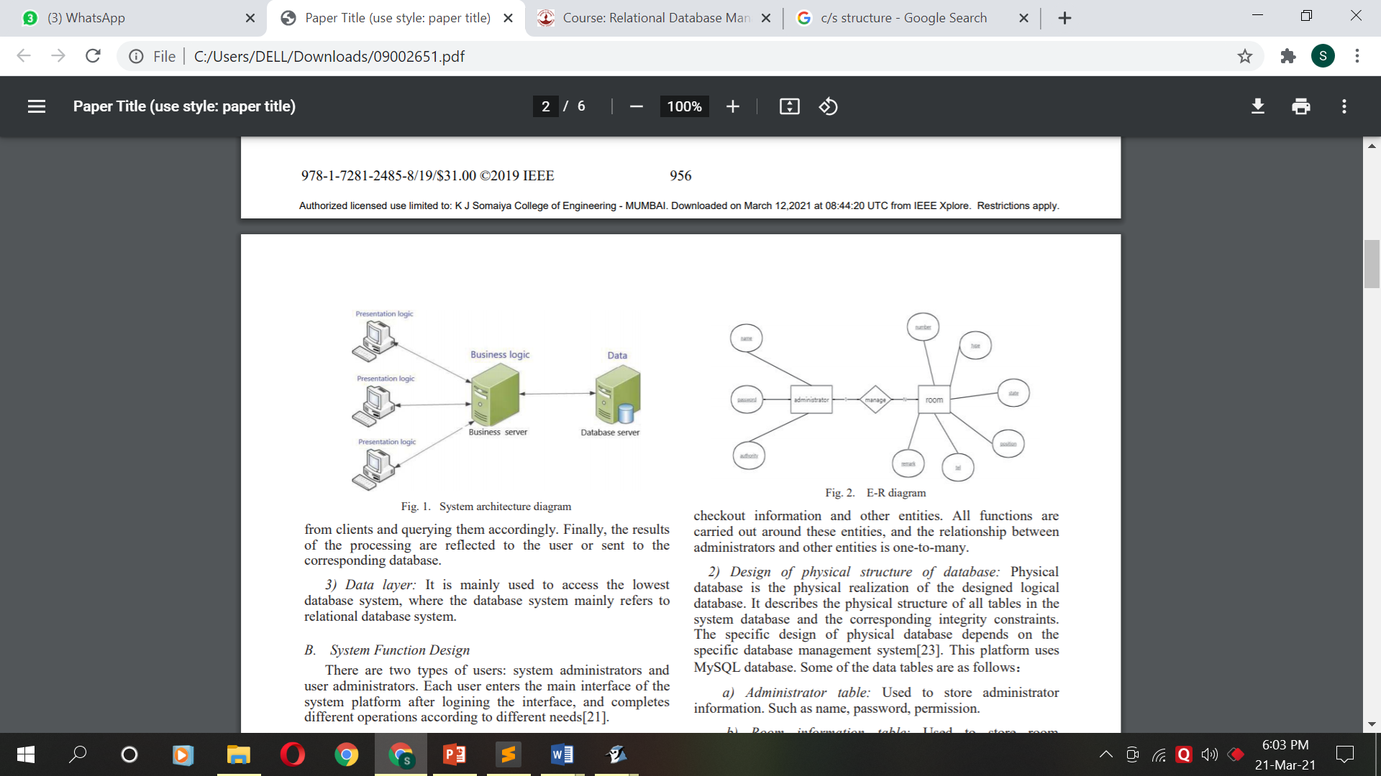
2) Business layer: It is responsible to the corresponding business logic processing and the corresponding presentation logic generation of the designed platform, and support requests from clients and querying them accordingly
3) Data layer: It is mainly used to access the lowest database system, where the database system mainly refers to relational database system.
System architecture design

Slide 7
System Function Design
In this system there are 2 users: system administrators and user administrators.
User enters the main interface after logging in and then completes different tasks on basis of its needs.
Module Description:
Login module: Function of user logging.
Individual billing module: Administrator realizes the checking in the room

Slide 8
3) Room reservation module: This module has all the information about the reservations completed by the administrator.
4) Guest Checkout module: This module takes care of the check out and pays the bill.
5) Business query module: Takes care of all the guest queries.
6) Customer management module: To edit, add and delete the members.
7) System setup module: Realizes room type management, customer type management, operator management functions.

Slide 9
Database Design
Design of logical structure of database: It refers to the logical structure that transforms the basic ER diagram of the conceptual structure design phase into the data model.
Design of physical structure of database: It contains of different tables such as administrator table, room information table, booking information table and statement information.

Slide 10
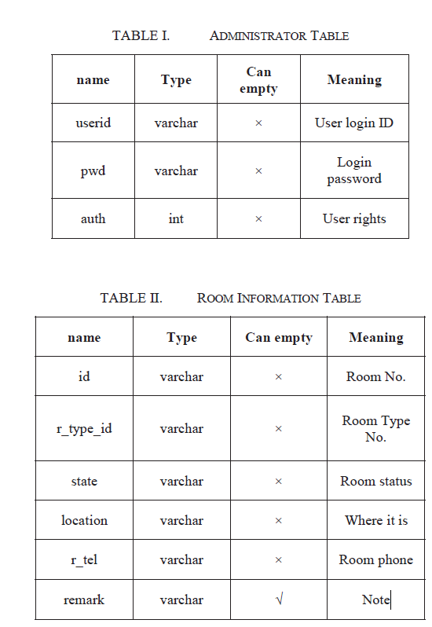
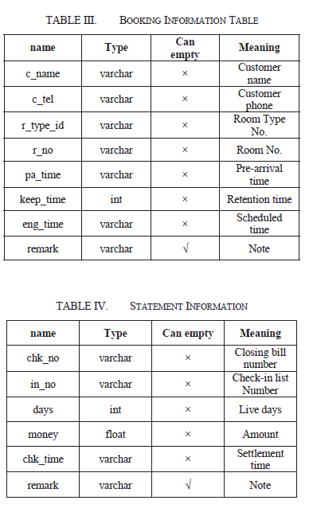

Slide 11
System Implementation
System physical structure: It contains of all the modules and the modules have the queries and the information that can be deleted, edited or added.
Realization of main functions:
System login : This interface is used to login in the system for all the administrators. It asks for the username and the password. For login all the administrators are in a dropdown list and the password is to be entered. On login, we will see the main interface which includes all the different functions that can be performed by the administrator.

Slide 12
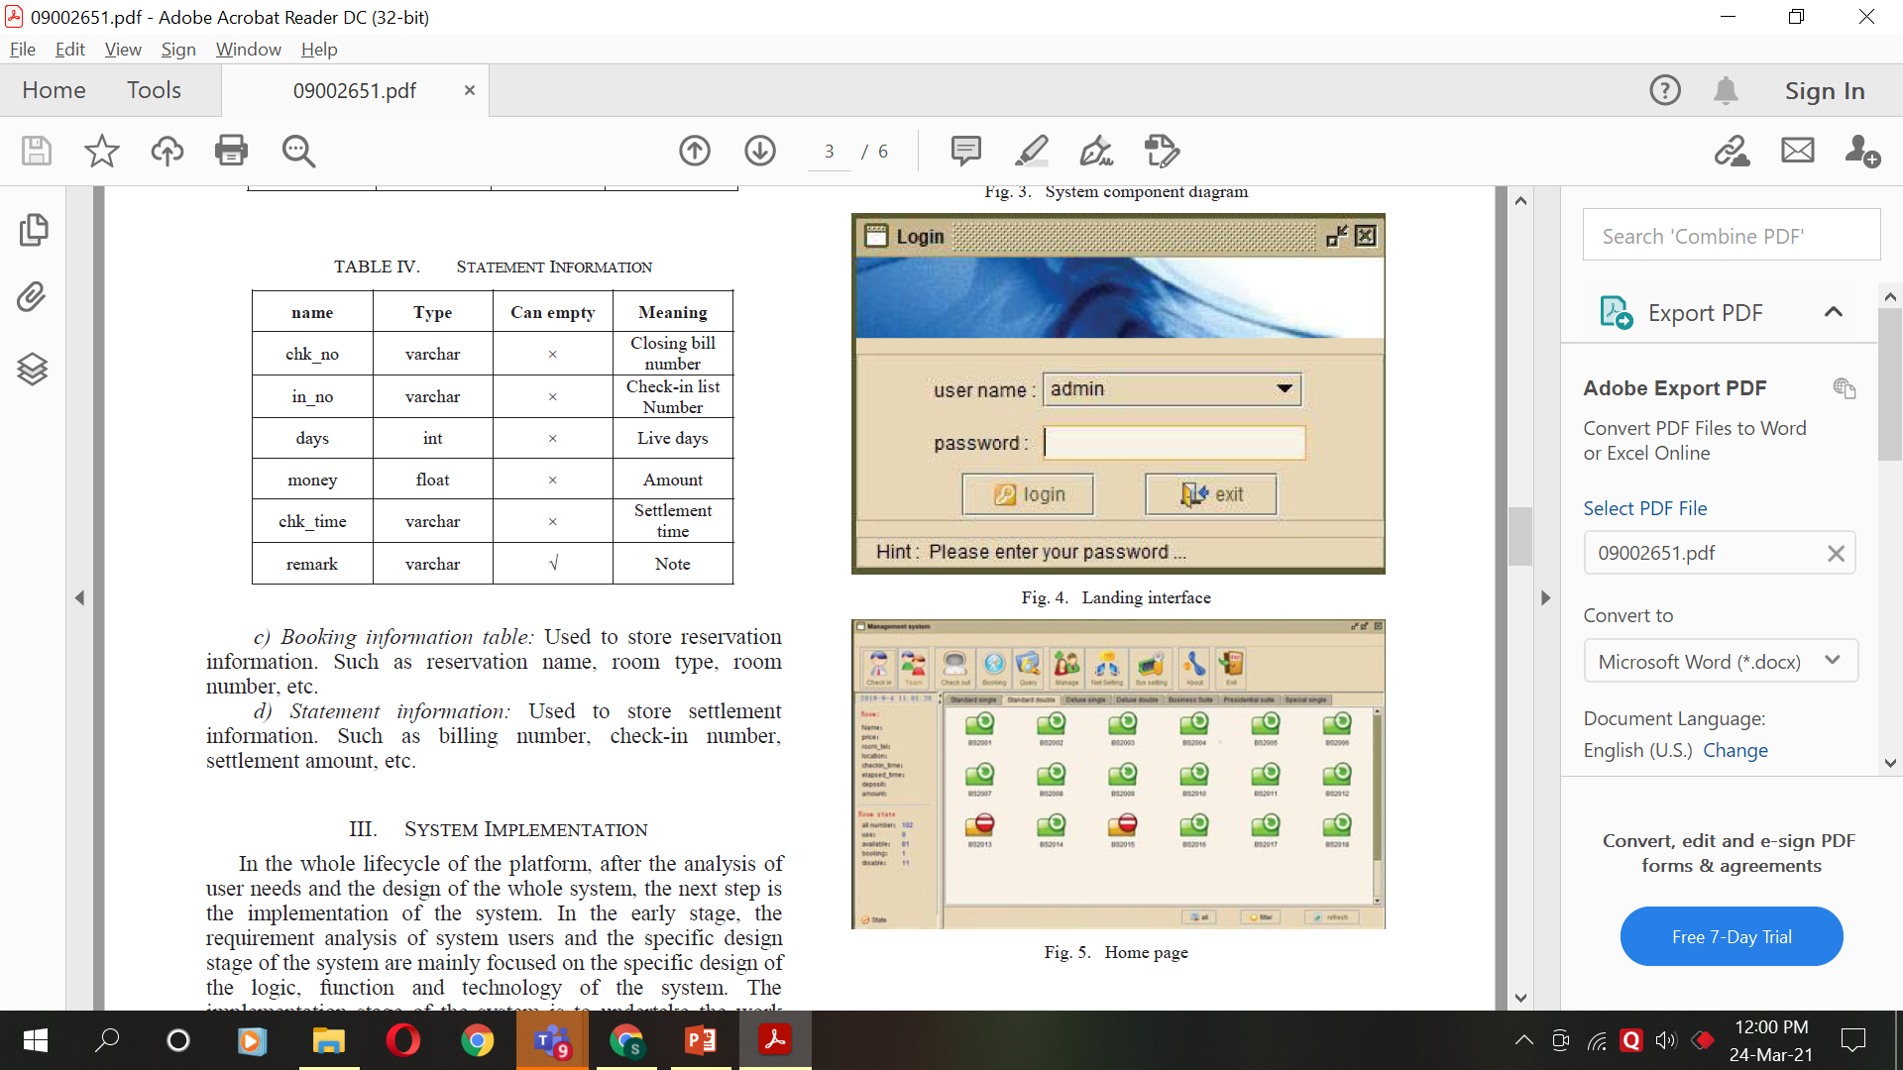
Home Page
Login Page

Slide 13
2) Room Reservation :
In this System you can book a room in advance. When we reserve a book in advance the state of the room is changed to block. In this interface we can edit all the reservation information. This information can be queried using room number or name .
Room Reservation Interface

Slide 14
3) Guest Checkout :
This interface is used to checking out. We can access this using the room number in which the guests are checking out. It then checks for the bill and the amount paid and amount due. For successful checkout the room is made available after 30mins.
Room Checkout Interface

Slide 15
4) Guest Check in :
This interface is used to checking in. To check in, we need to enter the room number which displays all the other information about the room. It then asks for the guest information. After the guest information is filled successfully the room is allotted and the state of the room is changed to living.
Room Checkout Interface

Slide 16
Implementation of main classes
Login Class: It takes care of the login system. It checks for the correct input and if successful shows the main interface.
Checkout Class: The Checkout class is used to construct the settlement interface and save the data after settlement.
HotelFrame Class: It is used to display the system's home interface. On successful login the system's main interface will be displayed. At this time, the server of the system will read the corresponding data from the database and initialize the interface of each part of the main interface.

Slide 17
Conclusion and observation
This platform adopts the principle of software engineering and completes the design and implementation of hotel room management system by analyzing the market demand by giving detailed design of each part of the system.
It realizes the importance of hotel room management and plays a positive role in improving the efficiency of hotel room management information.
It is an advanced, applicable and reliable system which helps us to meet the long-term development goal of the system.

Slide 18
Implementation Strategy
Create a database with all the tables that are implemented in the paper.
A simple and a better looking UI to be implemented.
Instead of a desktop application, I will be creating a website in django with sqite databse.

Slide 19
Thank You

